Slide 1

Human Activity Data Analytics
Presented by: Wee Jia Yi

Slide 2
Presentation Outline
Background Introduction
Related Work
Project Details - Framework - Experiments

Slide 3
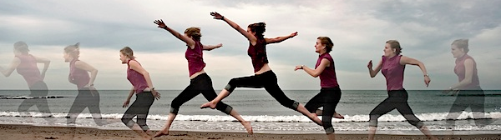
Background: Human Activity Data Analytics
Using combinations of information sources to predict an activity
Human Motion Recognition
Basic motions (e.g. sitting)
Transitional motions (e.g. falling down)
Integration of a Context Pyramid
Endless possible applications in different fields
Medical, security, etc.

Slide 4
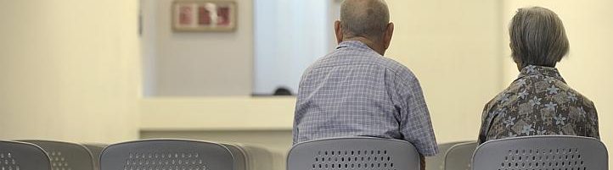
Motivation
Aging Population
Lucrative Grey market
elderly friendly technologies, retirement villages
Demand for robust and non-intrusive monitoring system
need for more reliable motion recognition framework
Notes:
Ministry of Health announced that the government will invest S$500 million to build 10 new nursing homes, 29 senior care centers and 56 senior activity centers by 2016. In addition, the Senior’s Mobility and Enabling Fund was expanded from S$10 million to S$50 million to provide subsidies for assistive devices and healthcare consumables.
• 87 percent will be healthy and independent, • 8 percent will require a walking aid, • 3 percent will require some assistance to move around and need some assistive device, • 1 percent will require total physical assistance for movement, • 1 percent will be bedridden.

Slide 5

Related Work
Use of various classification models (Hidden Markov Models, Support Vector Machines)
Identified needs in the field of Human Activity Data Analytics:
A broad and diverse range of data sets
- Elderly profile motion dataset
A robust recognition framework
- Resource friendly
- High generalization capability
- Tolerance to noise
More work in the area of motion transition recognition

Slide 6
The Human Activity Data Analytics Project
Objectives - Framework - Experiments

Slide 7
Project Objectives
Establish a new framework- Robust Activity Recognition with Motion Transition
Construct a new dataset- Diversified Age Group Dataset
Experiments and Result Analysis
1
2
3

Slide 8
The Robust Activity Recognition with Motion Transitions framework
RARMT

Slide 9

RARMT’s Highlights
High generalization capability across different population groups
Tolerant to noises
Insensitive to smartphone’s position and orientation
Ability to recognize motion transitions

Slide 10
RARMT Framework Components
Preparing the data
Train the model
Test the model
5
High Level Motion Recognition
Data Collection Android Application
Sensory Data Preprocessor
Feature Extraction
Machine Learning Classifier
Testing and Results Analysis
1
2
3
4
Java
6
Android
Java
Matlab
Matlab
Optimal Parameter Selection
Matlab
RARMT Framework

Slide 11

1. Data Collection
Android Sensor Framework
Sound Signals
SQLite and browser

Slide 12
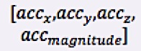
2. Data Pre-processing
Raw Sensory Data
[raw acc records]
Processed Sensory Data at fixed frequency
Processed data with magnitude
Define sampling frequency
Calculate Magnitude
Limitation of the android sensor framework
4th dimension (magnitude) for higher performance
Notes:
since acceleration magnitude is a measure of quantity of acceleration and has no direction, it is insensitive to the orientations of the smartphone. In order to relieve the influences of the device orientation (exact orientation of acceleration is unknown), extracting the magnitude of sensor readings sensitive to directions allows the classification model to acquire much improved generalization capability.

Slide 13

3. Feature Extraction
(b)
Accelerometer Data
1 sec data
1 sec data
1 sec data
1 sec data
1 sec data
1 sec data
Frame (a)
(c)
. . .
c
b
a
Adjusted as needed
Frame Size = 2sec
Extracted Features: 5 feature types (i.e. 22 features) used for classification
One Record for each Frame: Mean, Variance, Energy, Frequency_Domain Entropy, Correlation
Min-Max Normalized Data
Notes:
All extracted features have to go through normalization to prevent attributes in greater numeric ranges from dominating those in smaller numeric ranges.

Slide 14
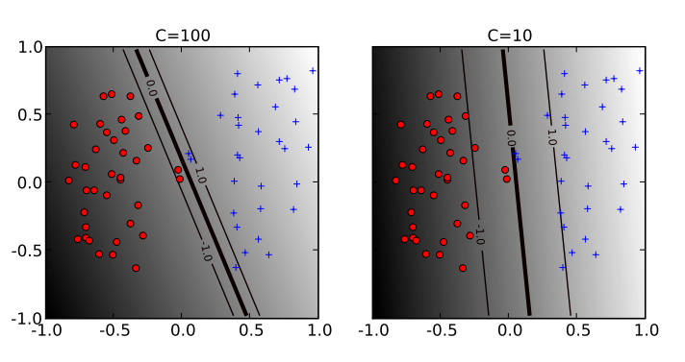
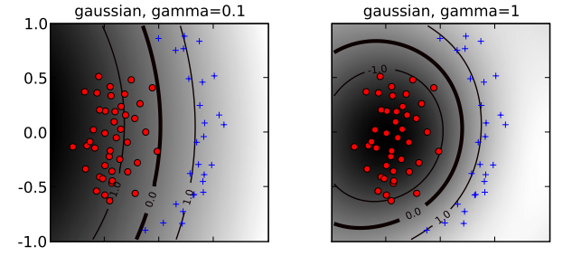
4. Support Vector Machine Classifier
LibSVM with Radial Basis Function is used
Cost (C): Trade-off between training error and flatness of the solution
Gamma (G): Controls the width of the insensitive zone
Grid-Search is used to find the optimal C & G parameters
Notes:
main rationale behind choosing the RBF kernel is that it nonlinearly maps samples into a higher dimensional space so that it can easily handle the case when the relation between class labels and attributes is nonlinear.

Slide 15
5. High Level Motion Transition Recognition
Two categories of motion
Low Level Basic Motions
High Level Transition Motions (normal, falling)
Lying
Sitting
Walking
Running
Standing

Slide 16


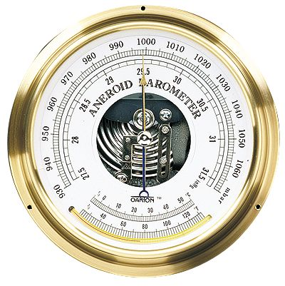
5. High Level Motion Transition Recognition
Choice of inputs and threshold determination
Barometer Standard Deviation Values
Generated from SVM classifier
Lying; Sitting; Standing; Walking; Running
Low Level Motion Prediction Labels
Generated from Feature Extraction
Able to determine altitude from sea level
Signal Magnitude Area Values
Able to differentiate between stable/ unstable state of motion
Generated from Feature Extraction
Thresholds used for transition recognition (to be determined via experimentations)

Slide 17
Motion Transition Recognition Test: Thresholds
Signal Magnitude Area Trend:
Observation:
Sharp change in SMA values upon motion transition
Use SMA’s Standard Deviation as threshold to differentiate between steady motion and transition motion

Slide 18
Motion Transition Recognition Test: Thresholds
Barometer Trend:
Observation:
Sharp change in raw Barometer values upon Falling motion
Use Sum Of Barometer’s Standard Deviation as threshold to differentiate between normal motion transition and falling motions

Slide 19
5. High Level Motion Transition Recognition
The Algorithm
Low level motion prediction labels
SMA values
Barometer standard deviation values
Feed in Inputs
Get processing window
Calculate SMA’s std-dev
Noise Data
No
Exceed SMA’s std-dev threshold?
Yes
Transition Data
Data Smoothing Process
Calculate Barometer’s sum
Normal Motion Transition
No
Exceed Barometer sum threshold?
Yes
Falling Down Transition
Notes:
Mention the assumptions made
Data smoothing done by majority voting

Slide 20
6. Results Analysis
(A) Performance Test Method used:
Cross Validation
Leave One User/ Group Out
10 Folds Cross Validation
1 |  |  |  | ……
Testing Data
 | 2 |  |  | …
Training Data
…
…
…
 | 2 | 3 |  | … | 10
YOUTH DATA | ELDERLY DATA
Training data
Unseen testing data

Slide 21

6. Results Analysis
(B) Performance Metric Used:
. F-Score Calculation
 |  | Predicted Class
 |  | A | B
Actual Class | A | True Positive (TP) | False Negative (FN)
 | B | False Positive (FP) | True Negative (TN)

Slide 22
Revisit: Project Objectives
Establish a new framework- Robust Activity Recognition with Motion Transition
Construct a new dataset- Diversified Age Group Dataset
Experiments and Result Analysis
1
2
3

Slide 23
The Diversified Age Group Dataset
Data Collection Set up and procedure

Slide 24
Dataset Overview
User Profiles:
Activity hours collected: 8hrs
 | User Gender | User Age
YOUTH | Female | 18
 | Female | 20
 | Female | 22
 | Male | 30
ELDERLY | Male | 67
 | Female | 65
 | Male | 70
 | Female | 80
Human Activity | Duration collected
 | Youth Group | Elderly Group
Lying | 70 mins | 35 mins
Sitting | 70 mins | 35 mins
Standing | 70 mins | 35 mins
Walking | 70 mins | 35 mins
Running | 75 mins | 10 mins
Note: Some elderly volunteers were unfit to perform the running motion. Hence, some running motions are not collected.

Slide 25
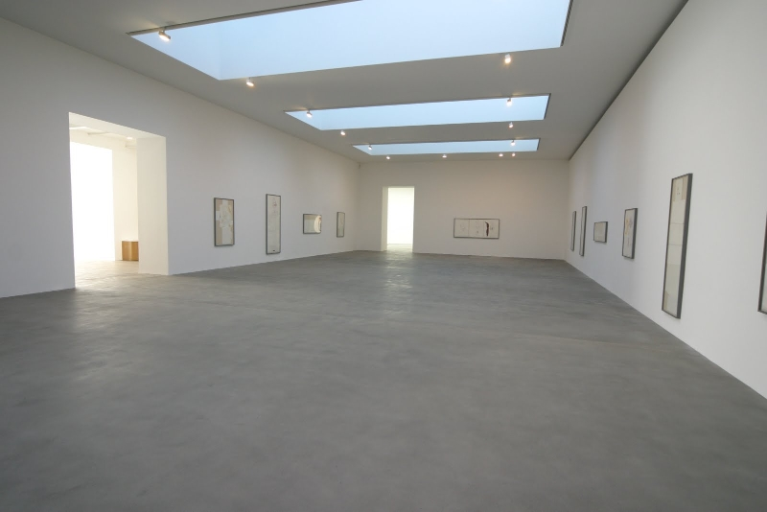
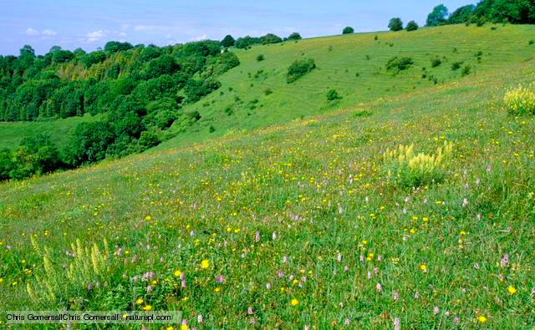
Dataset Overview
Experiment Conditions:
Varying terrains (e.g. hard cement ground/ soft uneven ground)
Varying clothing (e.g. tight fitting/ loose)
Varying pocket size
Smartphone can be placed in left/ right front trouser pockets

Slide 26
Revisit: Project Objectives
Establish a new framework- Robust Activity Recognition with Motion Transition
Construct a new dataset- Diversified Age Group Dataset
Experiments and Result Analysis
1
2
3

Slide 27
Experiments and Analysis
Benchmarking and Motion transition testing

Slide 28
Experimentation Objectives
Performance Testing Using Benchmark Datasets
Performance Testing Using the new Diversified Age Group Dataset
Performance Testing for Motion Transition Recognition

Slide 29
Benchmark #1: Lin’s Dataset
Overview:
Lin’s Dataset Profile
No. of Users/ Hours | 7 Users / 48.2 Hours
User Profile (age range) | 25-46
Activities Recorded | Stationary, Walking, Running, Bicycling, Ascending stairs, Descending stairs
Data Collection Device | Nokia N97 (Python Program)
Sensor/s Used | Accelerometer
No. Features Used | 22
Classification Model | libSVM with RBF kernel
Additional Information | Data collection on 6 different pockets locations and 4 phone orientations.

Slide 30
Benchmark #1: Lin’s Dataset
Benchmark test results:
General Trend
Frame Size Impact
Comparison
Notes:
We can see that the RARMT framework has consistently matched its performance to Lin’s Model.
This shows proof that we have successfully achieved the project objective of replicating the experiment based on concepts described in Lin’s work.
In fact, there is even a slight improvement in scores when using the RARMT framework. This is possibly due to the different C and G values used in this project’s experiments.

Slide 31
Benchmark #2: Davide’s Dataset
Overview:
Davide’s Dataset Profile
No. of Users | 30
User Profile (age range) | 19-48
Activities Recorded | Standing, Sitting, Laying, Walking, Walking upstairs and Walking downstairs
Data Collection Device | Samsung Galaxy S2 (worn with holder on the waist)
Sensor/s Used | Accelerometer and Gyroscope
No. Features Used | 561
Classification Model | Hardware friendly SVM with Noise Filter
Additional Information | A lesser number of bits were used in the SVM parameter estimation.

Slide 32
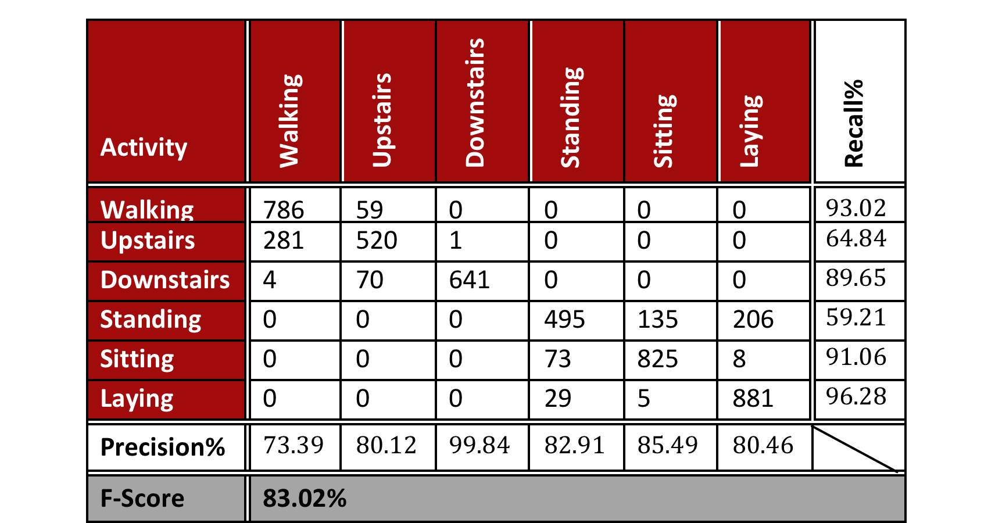
Benchmark #2: Davide’s Dataset
Benchmark test results:
Use 70% data for training, 30% data for testing
Note:
RARMT uses only 22 features and accelerometer data
There is no noise filtering done in RARMT
 | RARMT | Davide’s SVM | Standard SVM
F-Score | 83.02% | 89.3% | 89.8%
No. Features Used | 22 | 561 | 561
Notes:
Unfortunately due to the limitation of the data source, we were not able to expand the experiment to test out the effect of other factors (e.g. frame sizes).
In this case, the benchmark test with RARMT omits the acceleration and gyroscope information and uses only five different features.
We can observe a slight drop in performance of about 6% with the RARMT framework as compared to Davide’s hardware friendly SVM model.
However, RARMT achieved a comparable results of 83.02% F-score despite working with a much smaller dimension of information - one sensory inputs (instead of three) and 22 features (instead of 561),
This suggests that it is possible for a model to perform well even with a smaller set of information, as long as the most informative features are selected for the classification problem. Hence, it is probable for the RARMT framework to be more hardware friendly than Davide’s model although this experiment is not yet implemented and tested on smartphones.

Slide 33
Benchmark #2: Davide’s Dataset
Results Analysis and Insights:
Gyroscope readings may be omitted
Usefulness of the new 4th dimension (magnitude)
No direct correlation between the number of features and performance.
Notes:
Gyroscope readings may be omitted of features extraction already contains orientation information. In this case, with the 4th dimension (magnitude) of the accelerometer readings included, certain orientation information is captured. Hence, we can still achieve high performance without gyroscope data.
There is no direct correlation between the number of features and performance. Using more features used does not necessarily equate providing better results. It is important to identify and use only distinguishing features that have been empirically proven to be relevant to the problem type.

Slide 34
Experimentation Objectives
Performance Testing Using Benchmark Datasets
Performance Testing Using the new Diversified Age Group Dataset
Performance Testing for Motion Transition Recognition

Slide 35
Diversified Age Group Dataset
Experiment Set-up:
Cross Validation Test
Single user/ Multiple user profiles scenario
Leave One User/Group Out Test
Training Data | Testing Data
Entire DAG Dataset excluding User X | User X- a single unknown user profile
Youth Dataset | Elderly Dataset
Elderly Dataset | Youth Dataset

Slide 36
Results Analysis
No significant drop in performance for multiple user profile scenario test
RARMT has high generalization capability
Highly robust
Notes:
highly robust as it can handle a mixture of user profiles from such a wide age group range.

Slide 37
Results Analysis
LOO yields lower F-scores
LOO performs better with larger frame size
Optimistic observation: LOO testing in general yield high performance scores
Notes:
LOO testing generally yields lower F-scores than Cross Validation testing.
This is expected as LOO testing is a much more robust way in accessing the generalization capability of a model. The model is dealing with unseen testing data, hence there will inevitably be more prediction errors.
However, it is encouraging to note that the results are still consistently in the 85-90% range.
LOO testing performs better using a larger frame size
This is expected as unseen test data is used in LOO testing. Hence, the framework will require more information (larger frame size for feature extraction) in order to make a more accurate prediction.
LOO-X (leave single user out) testing yield a consistently high F-scores (~90%) across the different frame sizes.
This is an optimistic observation. It serves as a good indication that the model is likely to perform well in making activity predictions for an unknown user profile, when given a substantial training dataset (like the DAG). This potentially increases the usability of the system as it means that a new user does not have to go through a tedious data collection period in order to use the motion recognition system.

Slide 38
Experimentation Objectives
Performance Testing Using Benchmark Datasets
Performance Testing Using the new Diversified Age Group Dataset
Performance Testing for Motion Transition Recognition

Slide 39
Motion Transition Recognition Test: Overview
Motion transitions are transient in nature
Require small frame size
Frame Size of 1 seconds used in High Level Motion Transition Recognition tests
Low Level Motion Recognition Test Results Review:
 | Cross Validation | LOO-X | LOO-Elderly | LOO-Youth
Optimal Frame Size | 4 sec | 6 sec | 5 sec | 6 sec
Optimal F-score | 99.67% | 94.25% | 87.65% | 90.25%
F-score of 1 sec frame | 99.18% | 91.84% | 83.92% | 86.02%
F-score difference | 0.49% | 2.41% | 3.73% | 4.23%

Slide 40
Motion Transition Recognition Test: Results
High Accuracy [F-score: 96.52%]

Slide 41
Review of Experimental Results
Benchmarking, DAG, Motion Transition Tests

Slide 42
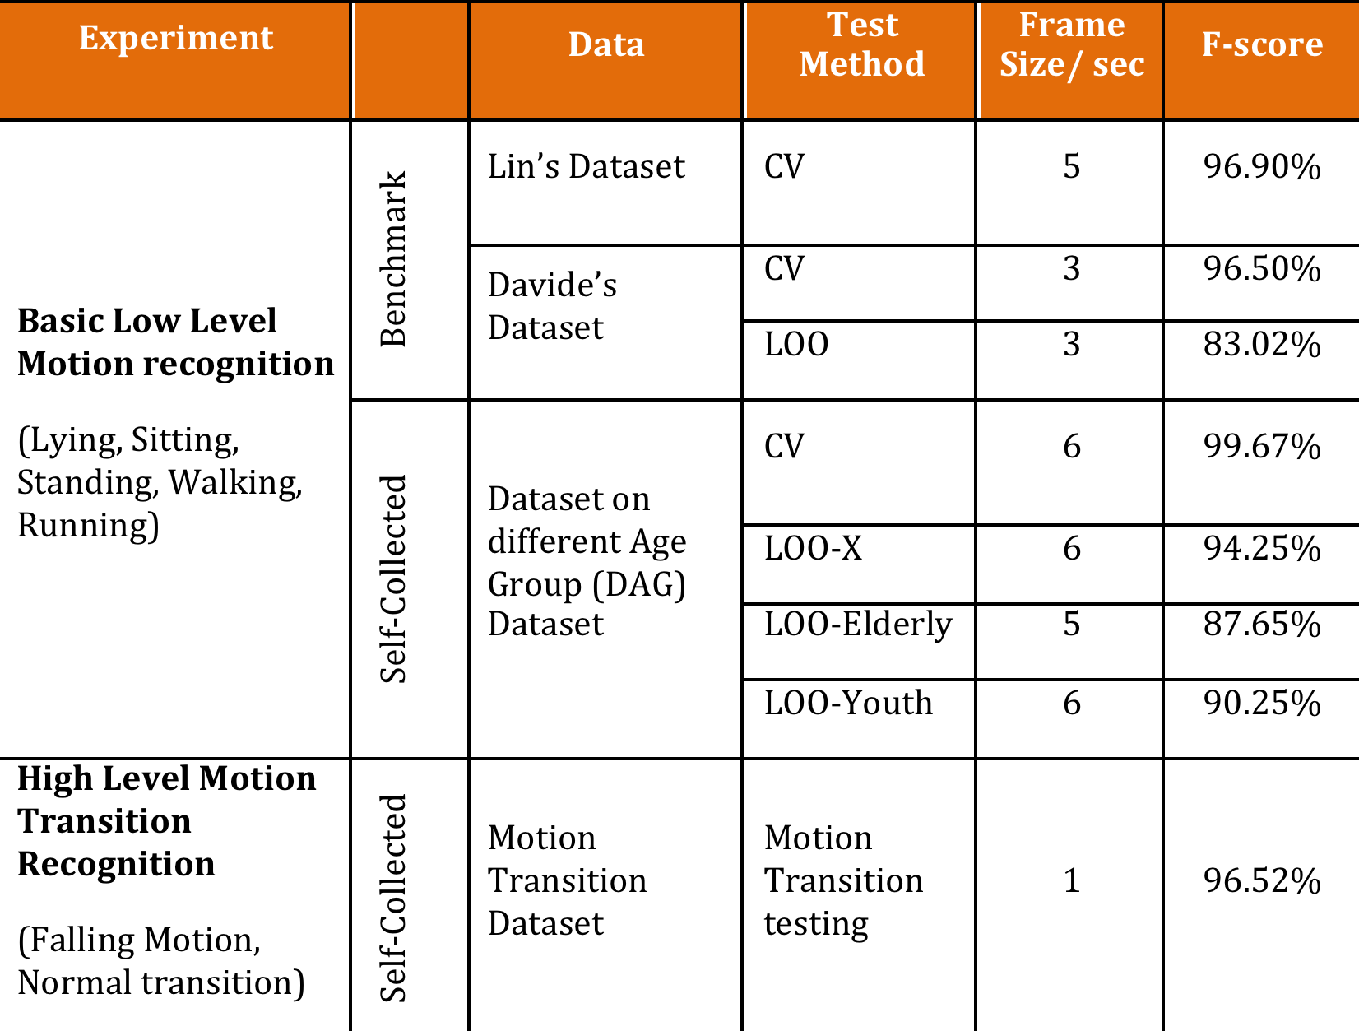
Results Summary
RARMT works well with a smaller information dimension
RARMT is tolerant to noises (robust)
RARMT is not sensitive to user profiles (high generalization capability)
RARMT recognizes motion transition accurately

Slide 43
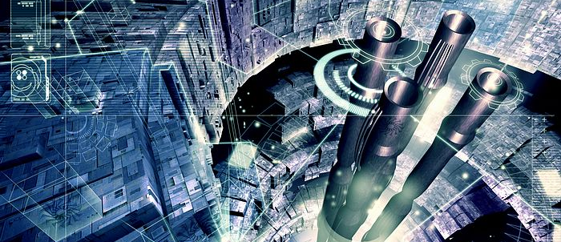
The Future
Outlook for Human Activity Data Analytics

Slide 44
Future Work: Overview
Human Activity Daily Living Pattern (ADL) analytical system
Driven by the RARMT framework
Integration with numerous information sources
Home Installed Sensors
Online Information
Smartphone
Smartwatch

Slide 45
The End

